Slide 1
Security Pitfalls for Workload Identities in Azure

Slide 2




Passwords & Passwordless
Trusted Location & Conditional Access
Trusted Devices & Authenticators
Sign-in Logs & Risk Policies
Notes:
When talking about authentication, we always talk about these things. But not…

Slide 3
We’re
not
talking about
users

Slide 4
We’re
talking about
Unmanaged Identities

Slide 5

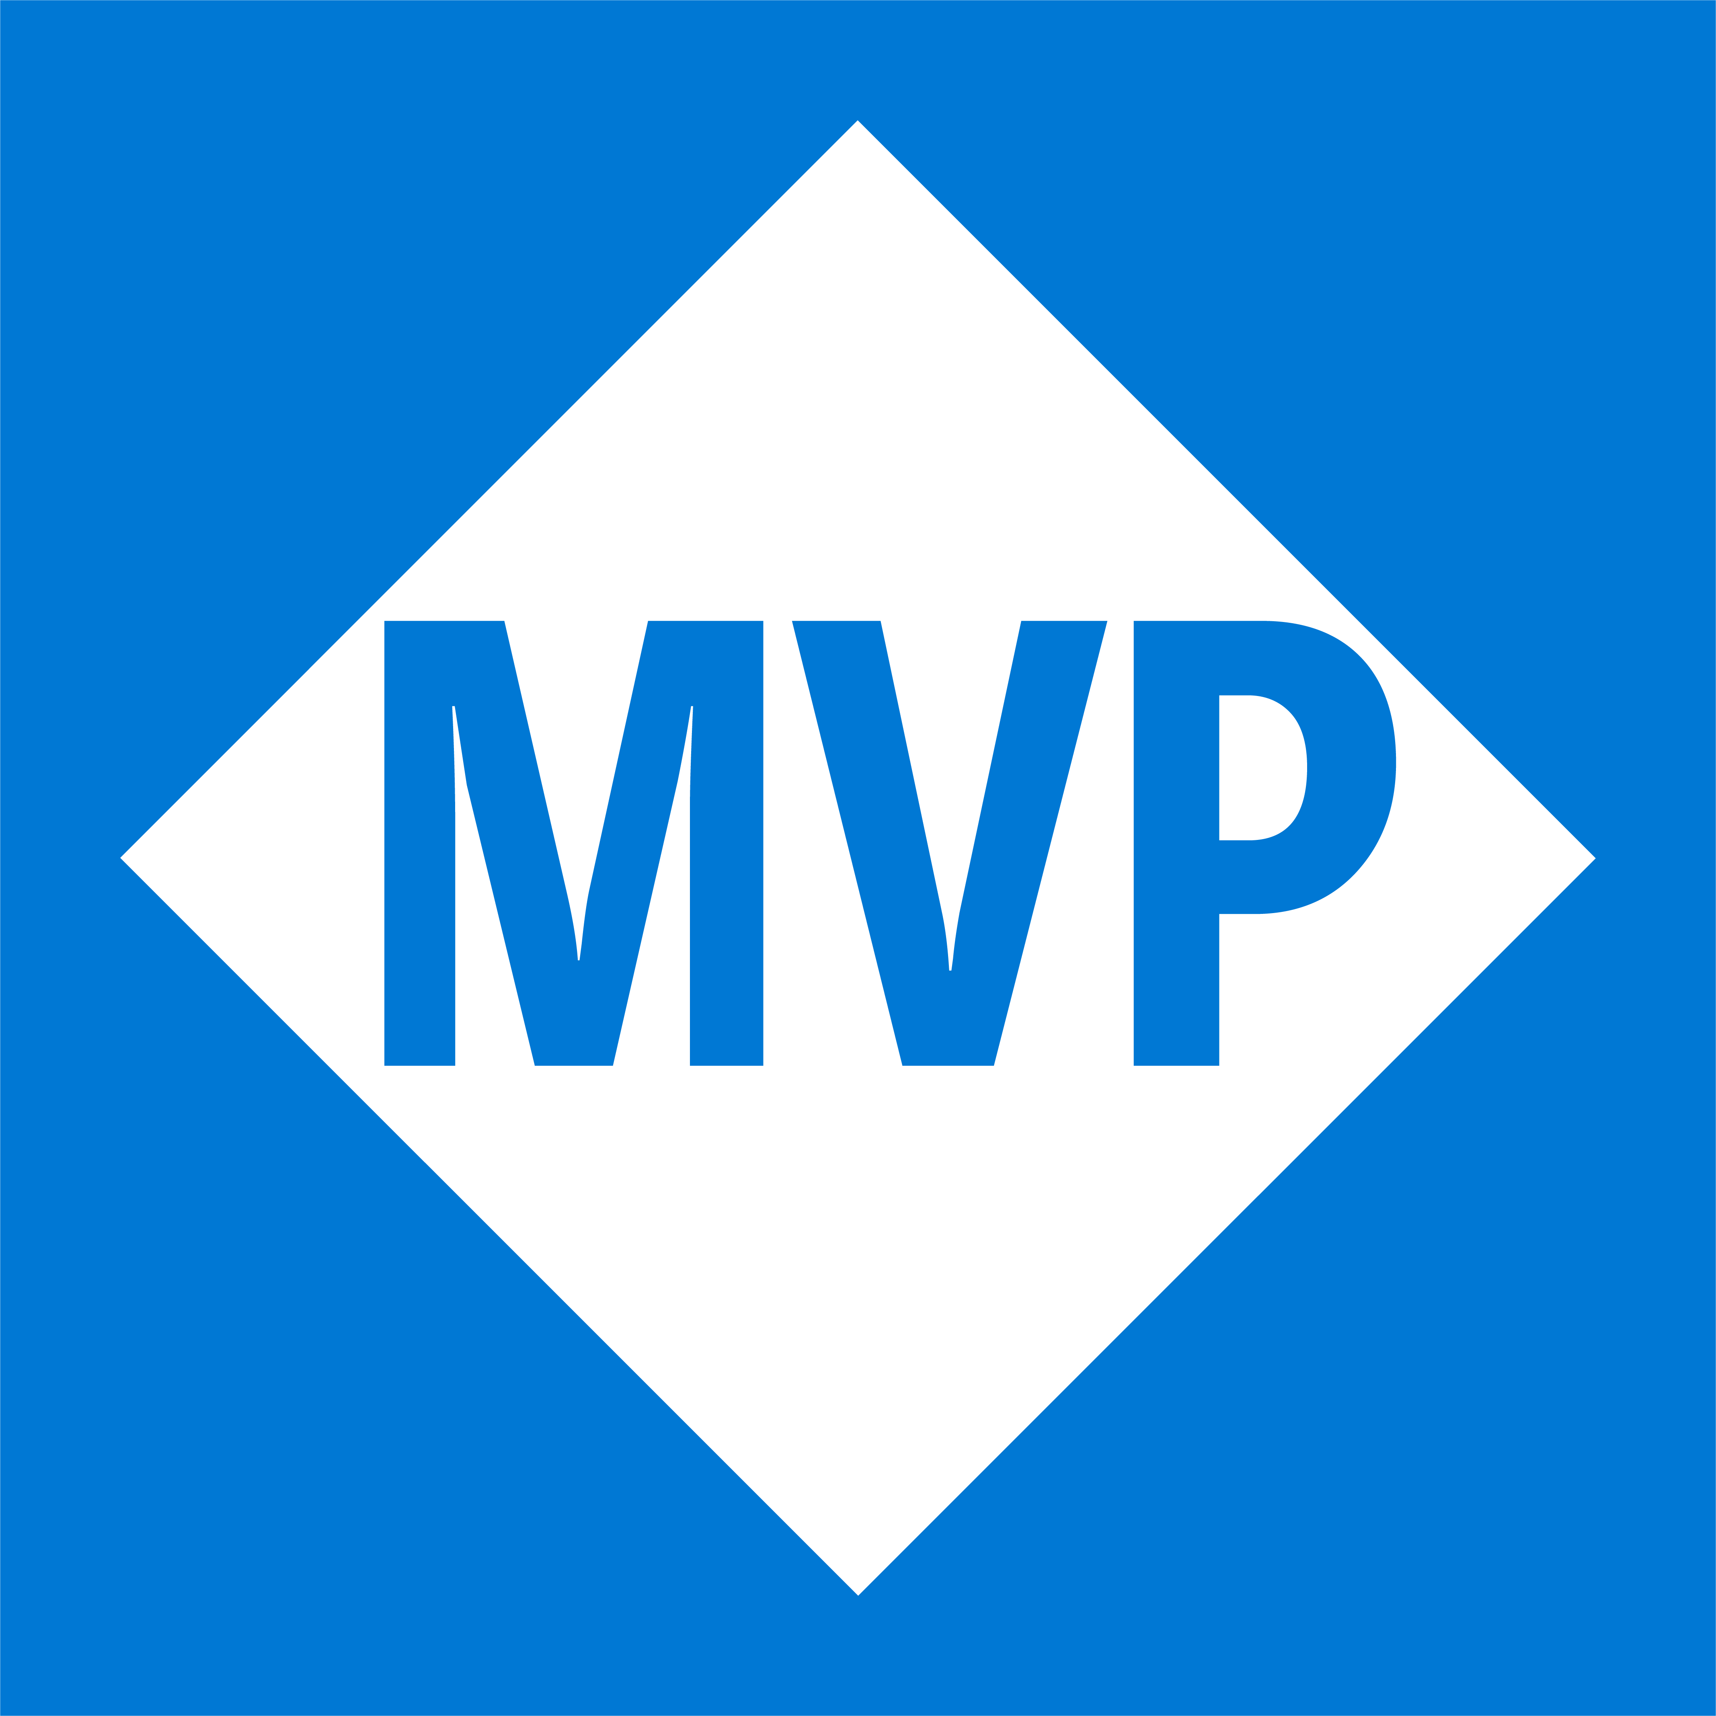
Emanuel Palm
@PalmEmanuel
🧙☕🍰🧗🥏
💙 Everything-as-Code
📦 Makes modules & tools
📃 Fan of Open Source
☁️ Blogs at pipe.how

Slide 6
PLACEHOLDER – THANK SPONSORS AND REMINDER TO EVALUATE THE SESSION AFTERWARDS

Slide 7
Session Overview
Workload Identities
Security Pitfalls
Summary
Questions
Notes:
Workload Identity Types
Security pitfalls
Summary
Questions

Slide 8
Identity Types
Workload
“A collection of application resources, data, and supporting infrastructure that function together towards a defined business goal.”
- Microsoft Azure Well-Architected Framework

Slide 9


Identity
Workload
Service Accounts
“In Microsoft Entra, workload identities are applications, service principals and managed identities.”
“There are three types of service accounts native to Microsoft Entra ID: Managed identities, service principals, and user-based service accounts.”
- Microsoft Entra Workload ID documentation
- Microsoft Entra documentation
Notes:
Traditionally, they would be called service accounts.

Slide 10



Identity
Workload
Types
App Registration
Enterprise Application
Application
Service Principal

Slide 11

Entra Tenant
Application
Service Principal

Slide 12
Entra Tenant
Application
Service Principal

Slide 13

Identity
Workload
Types
User-Assigned Managed Identity
System-Assigned Managed Identity
Application
Service Principal

Slide 14
Application
Service Principal
User-Assigned Managed Identity
System-Assigned Managed Identity

Slide 15

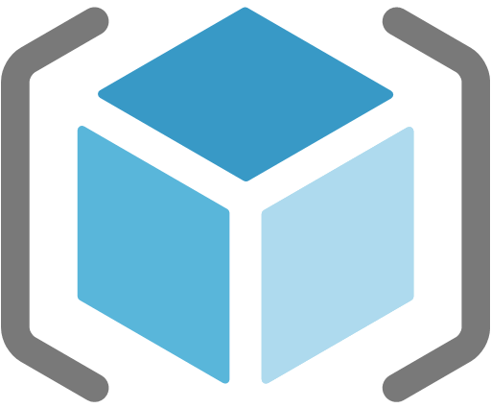
Federated Credential
🪪
Secret📝
Certificate🔑
Registered in a single tenant Needs Service Principal(s) for operations
Application
✅
✅
✅
✅
✅
❌
Service Principal
Created for an application in a tenant *
User-Assigned Managed Identity
Connected to one or multiple Azure services Has its own resource in Azure
❌
✅
System-Assigned Managed Identity
❌
❌
Fully managed by an Azure service ♻️

Slide 16
Notes
Consider mentioning “Service Accounts” somewhere early
When talking about user authentication. If we enable MFA and PIM, we’ve prevented a lot of threats. I don’t see people as worried about their passwords leaking anymore. To be honest, that partly feels like a solved problem. Passwordless and MFA is great.
A slide talking about MFA and PIM, and how we don’t have the option of that level of security for workload identities – we need to be restrictive with what access we give to non-personal accounts.

Slide 17
Security Pitfalls
A non-comprehensive list in no particular order. Pitfalls can be bad. In combination, disastrous.
Notes:
If my password gets leaked it’s bad. If I have permanent administrator rights without PIM, and no MFA on my account, that’s worse.
Principle of least privilege
Using Client Secrets (is bad)
Using old tooling, like AzureRm instead of Az for PowerShell. Sometimes the difference is not obvious, especially when the functionality is the same
Credential Management (if we really need them, use secret storage like KV and ensure that the process to issue new secrets etc is safe and controlled. Don’t email it!) Rotate credentials often, and if you do store secrets, think of also securing the storage fully
Not ensuring traceability (if I have access to of credentials as the app, it shouldn’t be possible for me to use it without my name showing (malicious insider)). Also audit and alerting for reading sensitive secrets if it’s not done by an identity that should
User-Assigned Managed Identities (unintentional assigning & Azure Policy works for them!)
Shared identities between services
Not using Workload ID (Conditional Access – IP ranges (if the identity should only be used from on-prem, limit it, if it should only be used from west europe Microsoft-hosted agents in Azure DevOps, limit it etc) & Risky sign-ins)
No clear life cycle process for all types (if we have clear on&offboarding for users, why would we allow these potentially less secure identities to be without?)
Accountability and ownership for the identities
Access reviews
Securing the entire supply chain and pipeline (doesn’t matter if the identity can only be used from a pipeline if that pipeline isn’t locked down too, and no one can override branch policies etc)
Going a little bit outside the scope of Workload Identities only, you should really consider implementing PIM for sensitive operations in Azure DevOps as well. Activations sometimes require a logout and login and a coffee break’s worth of waiting, but not having that permanent access is great.
Monitoring sign-ins and logs for anomalies
Too long access token lifetime policies (use proper refresh flows instead)
Not restricting who has access to use the workload identities

Slide 18
Principle of Least Privilege 🔓
1
Not following the
for the Workload Identities

Slide 19





Owner
Contributor
Reader
"roleName": “Owner", "permissions": [
{
"actions": [ "*“ ],
"dataActions": [],
"notActions": [],
"notDataActions": []
}
]
"roleName": “Contributor", "permissions": [
{
"actions": [ "*“ ],
"dataActions": [],
"notActions": [
…
],
"notDataActions": []
}
]
"roleName": “Reader", "permissions": [
{
"actions": [ “*/read“ ],
"dataActions": [],
"notActions": [],
"notDataActions": []
}
]
🤔

Slide 20
2
Using Old Versions and Tools 🛠️
Get right, stay right
Notes:
Using old tooling, like AzureRm instead of Az for PowerShell. Sometimes the difference is not obvious, especially when the functionality is the same

Slide 21



❌
AzureRM
Az

Slide 22
3
Not considering
The Entire Toolchain 🚀
Notes:
Securing the entire supply chain and pipeline (doesn’t matter if the identity can only be used from a pipeline if that pipeline isn’t locked down too, and no one can override branch policies etc)
Going a little bit outside the scope of Workload Identities only, you should really consider implementing PIM for sensitive operations in Azure DevOps as well. Activations sometimes require a logout and login and a coffee break’s worth of waiting, but not having that permanent access is great.

Slide 23




Privileged Identity Management
Azure
Azure DevOps
Service Principal
🧑‍💻
Resources
Azure Pipeline
Repository
Platform Engineer
👨‍💻
Privileged Identity Management
👩‍💻
Entra Administrator
Developer

Slide 24
4
Using Client Secrets 📝
They’re bad. Stop.

Slide 25
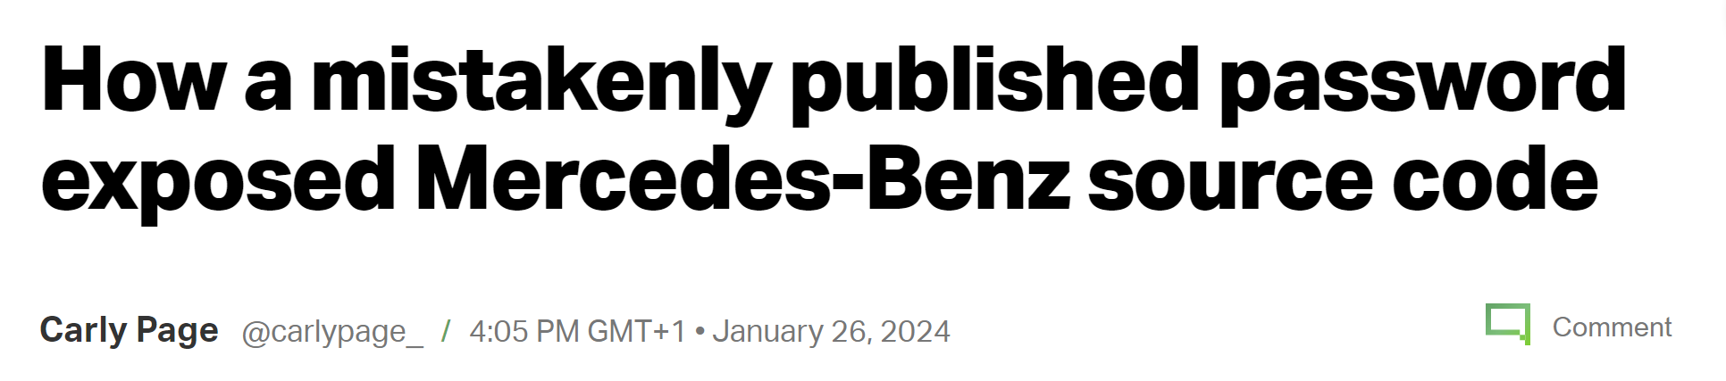
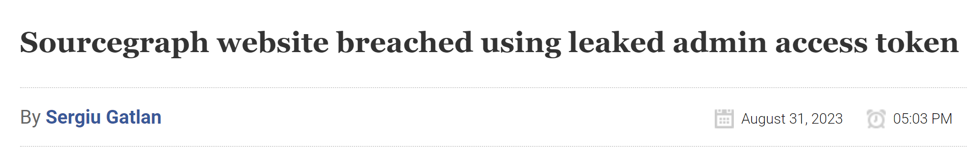
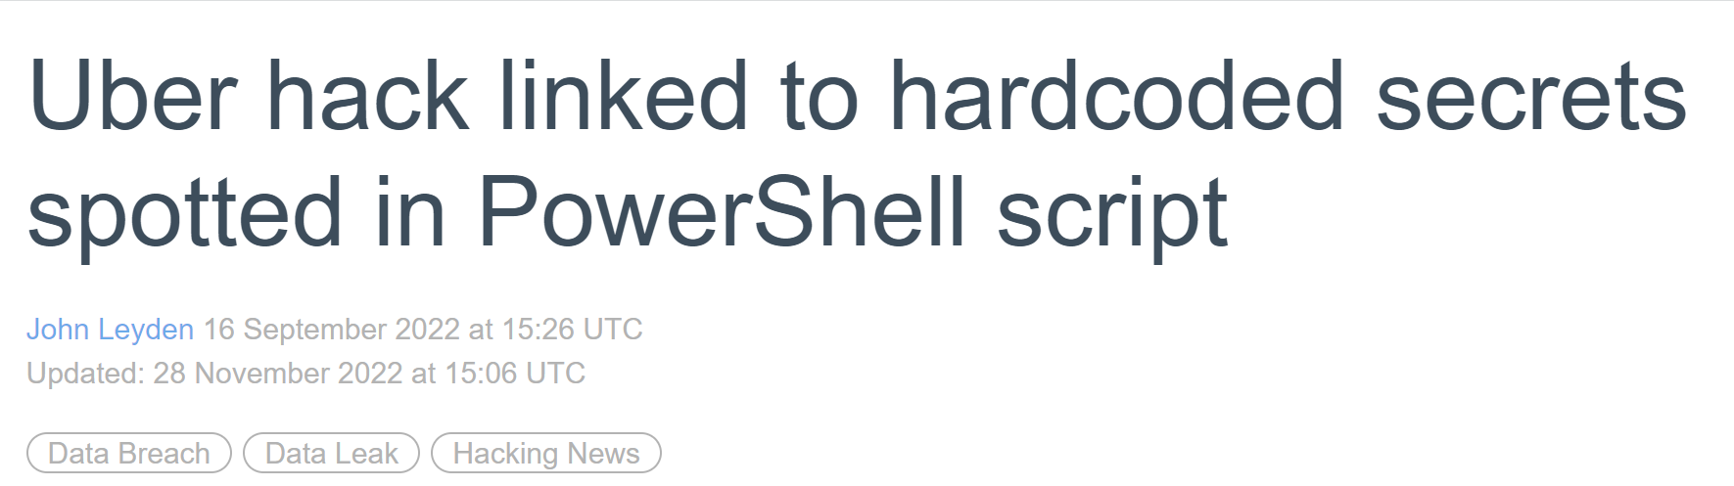
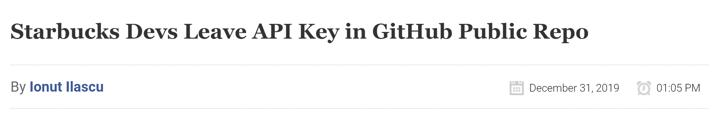
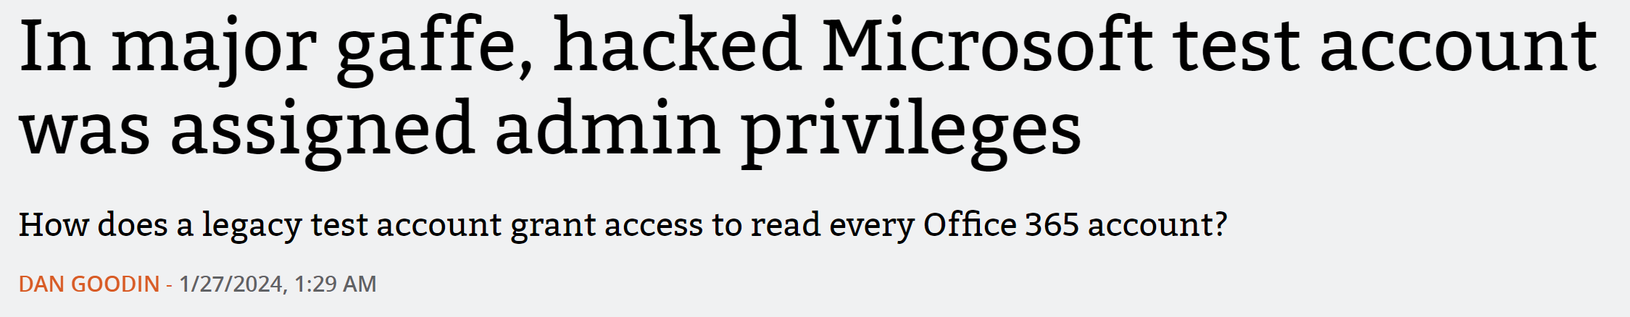

Slide 26
5
Missing Credential Management 🔐
Passwords, Tokens, Encryption Keys
Notes:
But… If we really do need passwords and secrets, we need to store them properly.

Slide 27
📖
🔐
🔁
Create a secure process for issuing!
Rotate secrets and keys often!
Secure the secrets, keys and storage!
Notes:
Don’t email secrets if they’re supposed to be secret. Adapt the process to different use cases.

Slide 28
6
Setting too long
Token Lifetimes ⌛
Notes:
Too long access token lifetime policies for applications (use proper refresh flows instead)
More and more things are implementing features like Continuous Access Evaluation so it’s better, but there are still bad ways to make things “easier” for ourselves.

Slide 29
7
Not Ensuring Traceability 🔍
for the entire process
Notes:
Not ensuring traceability (if I have access to of credentials as the app, it shouldn’t be possible for me to use it without my name showing (malicious insider scenario for example)).

Slide 30

Malicious Actor
🥷
2
Azure
Azure DevOps
1
🔍
Service Principal
👩‍💻
Resources
🔍
🔍
Azure Pipeline
Repository
🔍
Developer
Azure Key Vault

Slide 31
8
Not Monitoring and Acting 🕵️
Sign-ins, added credentials, anomalies
Notes:
Monitoring sign-ins and logs for anomalies. Audit and alerting for reading sensitive secrets if it’s not done by an identity that should.

Slide 32

Azure
Azure DevOps
Service Principal
👩‍💻
Resources
Azure Pipeline
Repository
Developer
Azure Key Vault

Slide 33
9
Not using Workload ID Premium 💎
Previously Workload Identity Premium for confusion

Slide 34
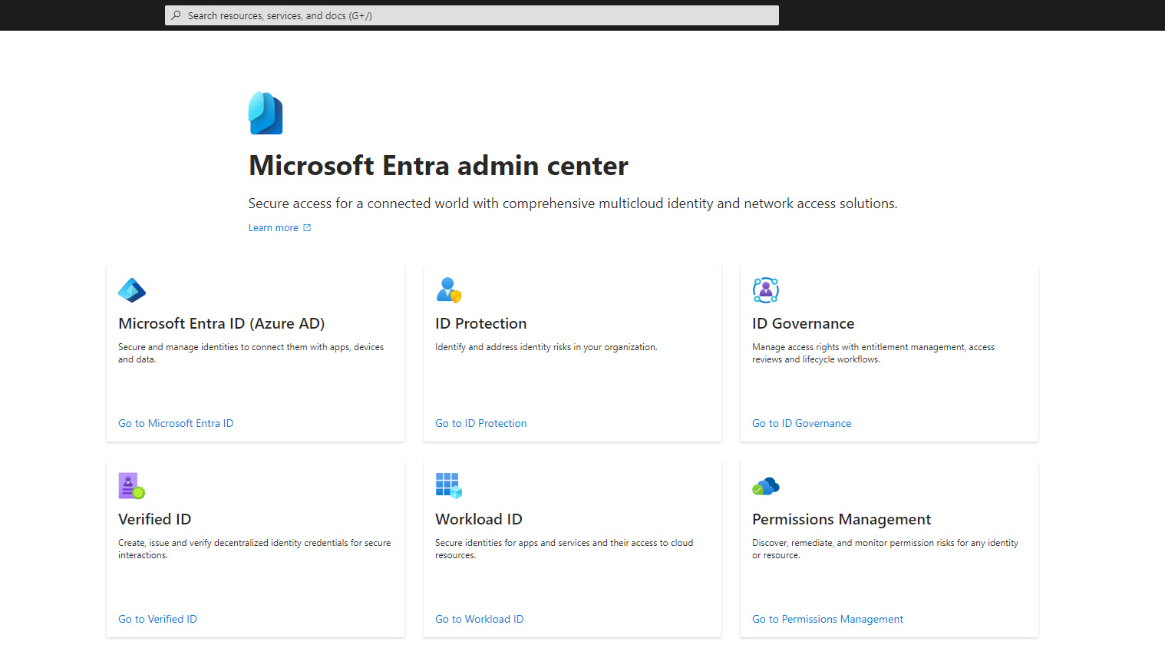
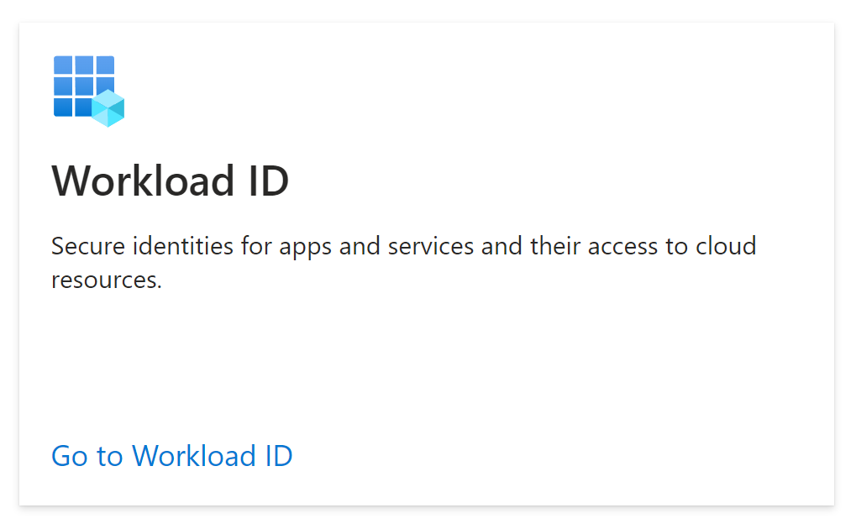

Slide 36



Workload ID Premium Features 💎
Location-based
Conditional
Access
Risk-based
Notes:
If the identity should only be used from on-prem, limit it, if it should only be used from west europe Microsoft-hosted agents in Azure DevOps, limit it etc
There is a scenario with IP based conditional access which is tricky for applications when using Federated Credentials, for the first token handshake.

Slide 37



Workload ID Premium Features 💎
Suspicious sign-ins
Leaked Credentials
Conditional
Access
Identity
Protection
🪄
Entra Threat Intelligence

Slide 38

Workload ID Premium Features 💎
Conditional
Access
Identity
Protection
Access
Reviews

Slide 39

Workload ID Premium Features 💎
Conditional
Access
Identity
Protection
Access
Reviews
App Health Recommendations

Slide 40
10
Creating and using
User-Assigned Managed Identities 👤
without a strategy
Notes:
User-Assigned Managed Identities (unintentional assigning & Azure Policy works for them!)
Azures best practices for Azure Policy for UAMIs are a bit off

Slide 41

Contributor
IT Operator
🧑‍💻
"roleName": “Contributor", "permissions": [
{
"actions": [ "*“ ],
"dataActions": [],
"notActions": [
…
],
"notDataActions": []
}
]
User-Assigned Managed Identity
Service Principal
GitHub Action
Secret 📝
🪪
Federated Credential

Slide 42
11
Sharing Workload Identities 👥
between multiple services
Notes:
There are few cases where it makes sense. In enormous organizations, Microsoft recommends it for certain policy scenarios, but those are edge cases.

Slide 43




Owner
Key Vault Crypto Officer
"roleName": “Owner", "permissions": [
{
"actions": [ "*“ ],
"dataActions": [],
"notActions": [],
"notDataActions": []
}
]
"roleName": “Key Vault Crypto Officer", "permissions": [
{
"actions": [ … ],
"dataActions": [
"Microsoft.KeyVault/vaults/keys/*",
…
],
"notActions": [],
"notDataActions": []
}
]
App Service
Kubernetes Cluster
AcrPull
"roleName": “AcrPull", "permissions": [
{
"actions": [
“Microsoft.ContainerRegistry/registries/pull/read”
],
"dataActions": [],
"notActions": [
…
],
"notDataActions": []
}
]
User-Assigned Managed Identity
Virtual Machine

Slide 44
12
Missing Lifecycle Process ♻️
On- & Offboarding for your Workloads
Notes:
No clear life cycle process for all types (if we have clear on&offboarding for users, why would we allow these potentially less secure identities to be without?)

Slide 45
13
Missing Accountability and Ownership 🏴‍☠️
Who’s in charge?

Slide 46
14
Missing Access Reviews 🚫
Why can this app do that?
Notes:
There was a preview of access reviews for service principals, but it seems to have been removed? Build your own!

Slide 47
Principle of Least Privilege 🔒
15
Not following the
for access to the Workload Identities
Notes:
Not restricting who has access to use the workload identities

Slide 48
Quiz time! Which solution is more secure? (Give the audience 10 seconds and point to a direction left/right, then say: it depends)
Service Principal with Federated Credential, used in a service connection in Azure DevOps
Can all pipelines use it?
Is it automatically triggered when new code is committed, and who can contribute with code?
Can someone override branch policies?
Who can add credentials to the service principal?
Is the pipeline running on Microsoft-hosted agents, or self-hosted? Can we set up Conditional Access policies based on Location?
User-Assigned Managed Identity used for a web app, assigned to a VM in Azure
Who can log into the VM?
Can anyone assign the identity to more resources?

Slide 49
Summary
🔓🛠️🚀📝🔐⌛🔍🕵️💎👤👥♻️🏴‍☠️🚫🔒
These are some of the pitfalls from my own experience, and there are countless more out there. There are many products that we didn’t dig into today that you can utilize in Azure, and many of them are great and should be looked into.
Stuff like Azure Policy, Sentinel and Defender (for Cloud Apps, for DevOps) which can show stuff like unusual credentials added to an app, or secrets left in files in your repositories

Slide 50


Thank you!
Questions?
pipe.how
@PalmEmanuel

